Slide 1
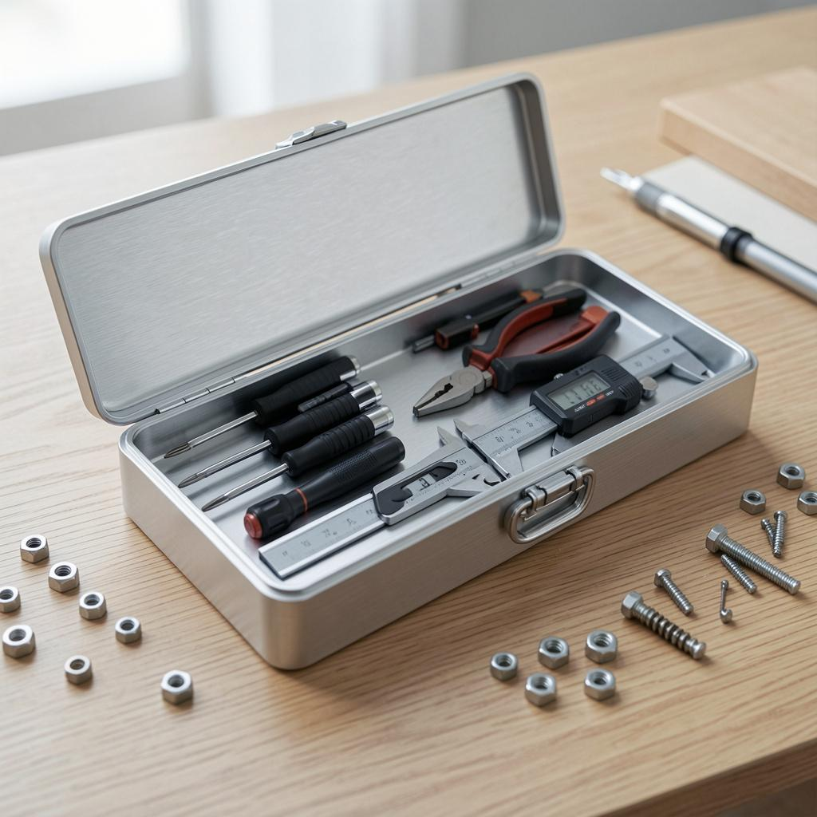
Multipurpose Tool
Versatile solutions for varied use cases and audiences

Slide 2

Introduction
Multipurpose platform that adapts to needs across teams and projects.
Offers a unified framework for customization, reuse, and rapid deployment. Focus on flexibility and efficient integration.

Slide 3
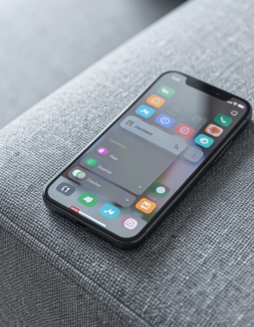
01
Core Features

Slide 4
Modular Design
Build with interchangeable components to match project scope.
Modules enable faster iteration and targeted functionality, reducing duplication and easing maintenance. Emphasizes reusability.

Slide 5
Scalability
Scale horizontally or vertically as demand grows.
Design supports incremental growth, performance optimization, and predictable cost management. Use autoscaling and monitoring for reliability.

Slide 6
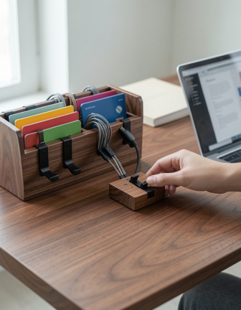
Customizability
Adjustable settings and plug-ins for diverse workflows.
Customizable UI and feature sets let teams enable only needed capabilities, improving focus and adoption.

Slide 7

01
Use Scenarios

Slide 8
Enterprise Solutions
Centralized management, role-based access, and integration with existing systems.
Supports SLA-driven operations and scalable deployments for large teams.

Slide 9
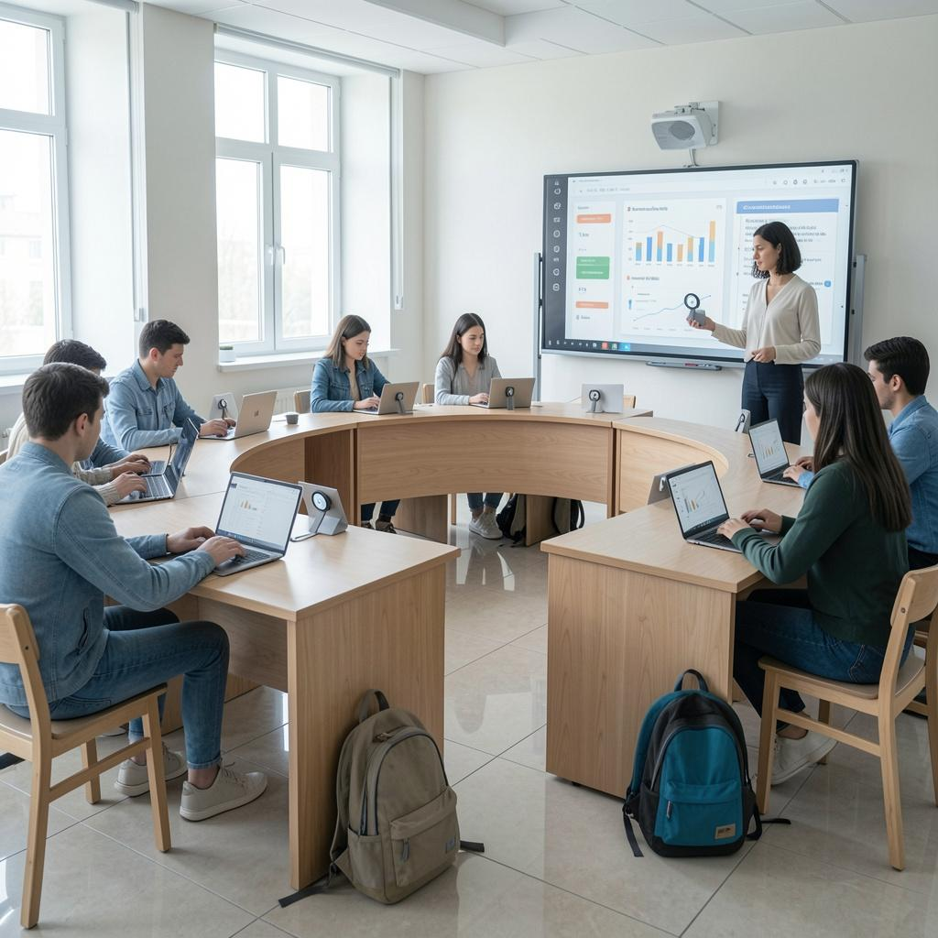
Educational Tools
Lightweight setup for classrooms and remote learning.
Offers templates, assessment modules, and analytics to track progress.

Slide 10
Personal Projects
Quick start templates and simple configuration for solo creators.
Emphasizes speed, minimal overhead, and easy sharing.

Slide 11
Conclusions
Adaptable platform that fits multiple contexts with focused features.
Prioritize modular choices, scalable architecture, and user-centric customization for best results.

Slide 12
Thanks!
Do you have any questions?
youremail@freepik.com
+91 620 421 838
yourwebsite.com
Please keep this slide for attribution

